Slide 1
Coursera Capstone project
Coursera IBM Data Science Certification
RIZA YILDIRIM
January 2020

Slide 2
Report Content
1. Introduction Section :
2. Data Section:
3. Methodology section:
4. Results section:
5. Discussion section:
6. Conclusion section:

Slide 3
Introduction
1.1 Scenario and Background
I am currently living in Istanbul. I also enjoy great venues and attractions, such as international cuisine, entertainment and shopping. I have an offer to move to work to Brooklyn NY
and I would like to move if I can find a place to live similar with similar venues.
1.2 Problem to be resolved:
How to find an apartment in Brooklyn with the following conditions:
• Apartment with min 2 bedrooms
• Monthly rent not to exceed US$5000/month
• Located within walking distance (<=1.0 mile, 1.5 km) from a subway metro station in Brooklyn
• Venues and amenities as in my current residence.
1.3 Interested Audience
I believe the methodology, tools and strategy used in this project is relevant for a person or entity considering moving to a major city in US, Europe or Asia. Europe, US or Asia, Likewise, it can be helpful approach to explore the opening of a new business. The use of FourSquare data and mapping techniques combined with data analysis will help resolve the key questions arisen. Lastly, this project is a good practical case for a person developing Data Science skills.

Slide 4
Data Section
2.1 Data Requirements
- Geodata for current residence in Istanbul with venues established using Foursquare.
- List of Brooklyn (BR) neighborhoods with clustered venues established via Foursquare (as in Course Lab). https://en.wikipedia.org/wiki/List_of_New_York_City_Subway_stations_in_Brooklyn
- List of apartments for rent in Manhattan area with information on neighborhood location, address, number of beds, area size, monthly rent price and complemented with geo data via Nominatim. https://www.realtor.com/apartments/Brooklyn_NY
2.2 Data Sources, Data Processing and Tools used
- Istanbul data and map is to be created with use of Nominatim, Foursquare and Folium mapping
- Brooklyn neighborhoods were obtained from Wikipedia and organized by Neighborhoods with geodata via Nominatim for mapping with Folium.
- List of Subway stations was obtained via Wikipedia, NY Transit web site and Google map,
- List of apartments for rent was consolidated from web-scraping real estate sites for BR. The geolocation (lat,long) data was found with algorithm coding and using Nominatim.
- Folium map was the basis of mapping with various features to consolidate all data in ONE map where one can visualize all details needed to make a selection of apartment

Slide 5
Methodology
The Strategy to find the answer:
The strategy is based on mapping the described data, in order to facilitate the choice of at least two candidate places for rent. The information will be consolidated in ONE MAP where one can see the details of the apartment, the cluster of venues in the neighborhood and the relative location from a subway station and from work place. A measurement tool icon will also be provided. The popups on the map items will display rent price, location and cluster of venues applicable.
The Tools:
Web-scraping of sites is used to consolidate data-frame information which was saved as csv files for convenience and to simply the report. Geodata was obtained by coding a program to use Nominatim to get latitude and longitude of subway stations and also for each of apartments for rent listed.
Geopy_distance and Nominatim were used to establish relative distances. Seaborn graphic was used for general statistics on rental data.
Maps with popups labels allow quick identification of location, price and feature, thus making the selection very easy

Slide 6
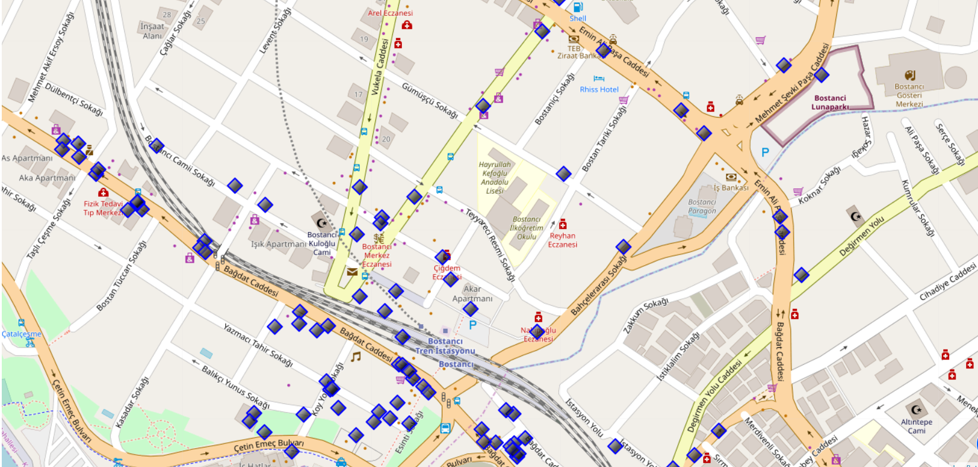
Execution and Results Current residence Neighborhood in Istanbul

Slide 7
Venues around Neighborhood
 | name | categories | lat | lng
0 | Cebecizade Türk Kahvesi | Café | 40.955631 | 29.097338
1 | Dondurmacı Yaşar Usta | Ice Cream Shop | 40.957193 | 29.097021
2 | Beşa Cafe | Café | 40.957551 | 29.097264
3 | Çaykur Çaykolik | Tea Room | 40.954341 | 29.094894
4 | Studyo pilates | Athletics & Sports | 40.958013 | 29.096092
5 | Bakıroğlu Gurme | Breakfast Spot | 40.957768 | 29.097471
6 | Tarihi Şen Lokanta | Turkish Home Cooking Restaurant | 40.954965 | 29.094332
7 | Bostancı Balık | Seafood Restaurant | 40.954465 | 29.095689
8 | Ekler İstanbul Bostancı | Dessert Shop | 40.957705 | 29.096905
9 | 1A Meyhanesi | Bar | 40.955151 | 29.094691

Slide 8
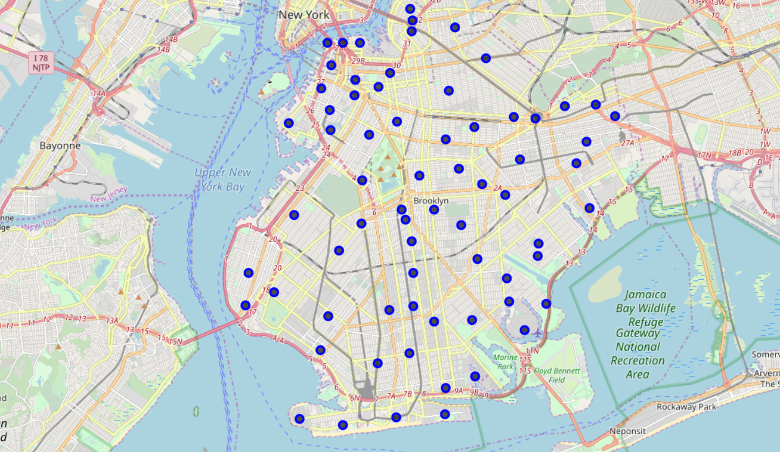
Brooklyn Map - Neighborhoods and Cluster of Venues

Slide 9
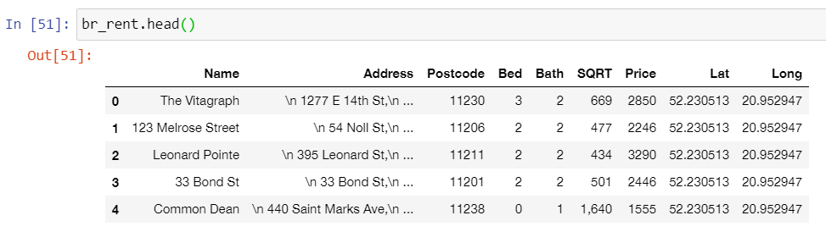
GeoData Brooklyn apts for rent

Slide 10
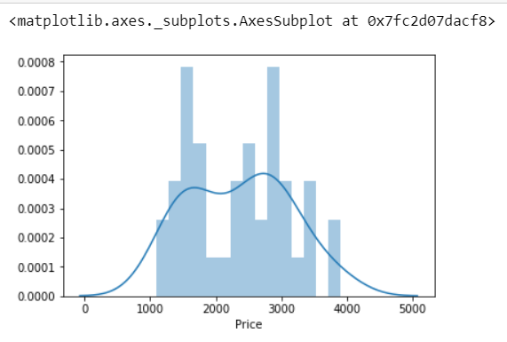
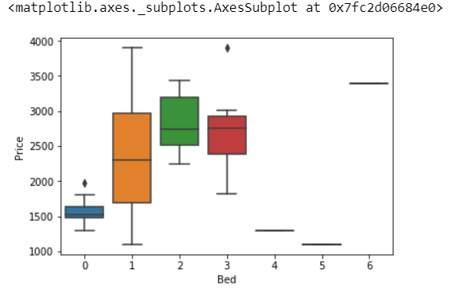
Rental Price Statistics BR Apartments Budget US5000/month is around the mean

Slide 11
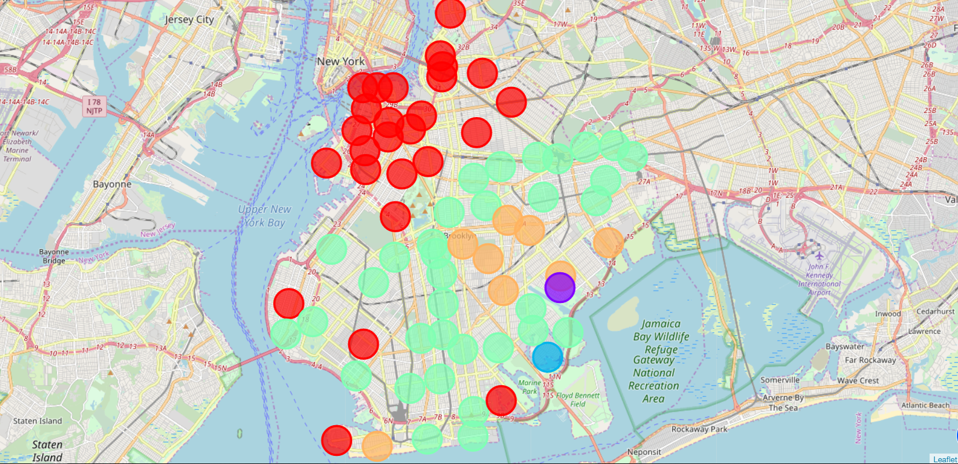
BR apartments’ venue clusters

Slide 12
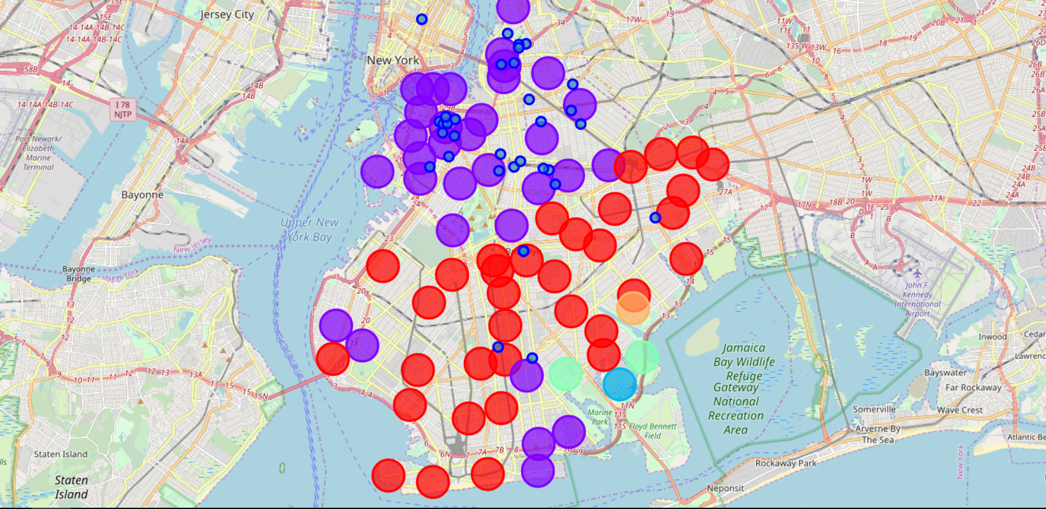
BR apartments for rent with venue clusters

Slide 13
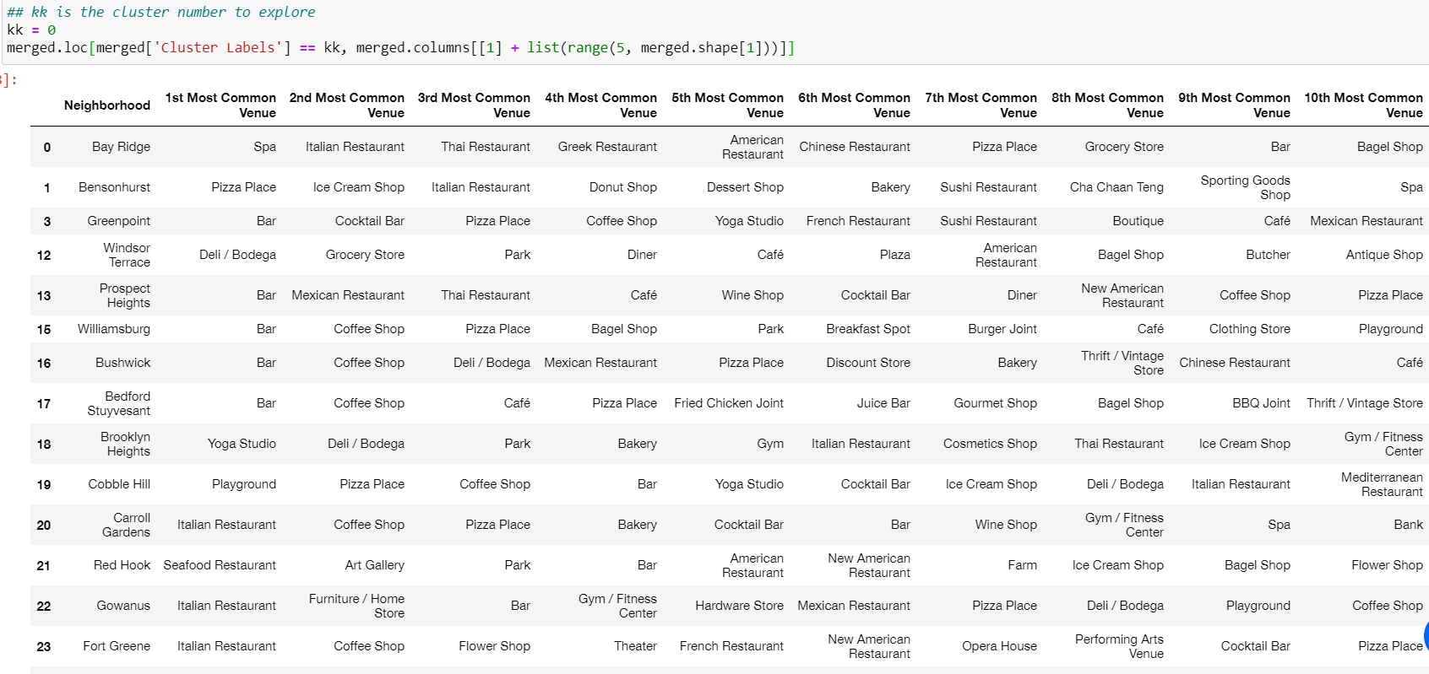
Venues of cluster 0

Slide 14
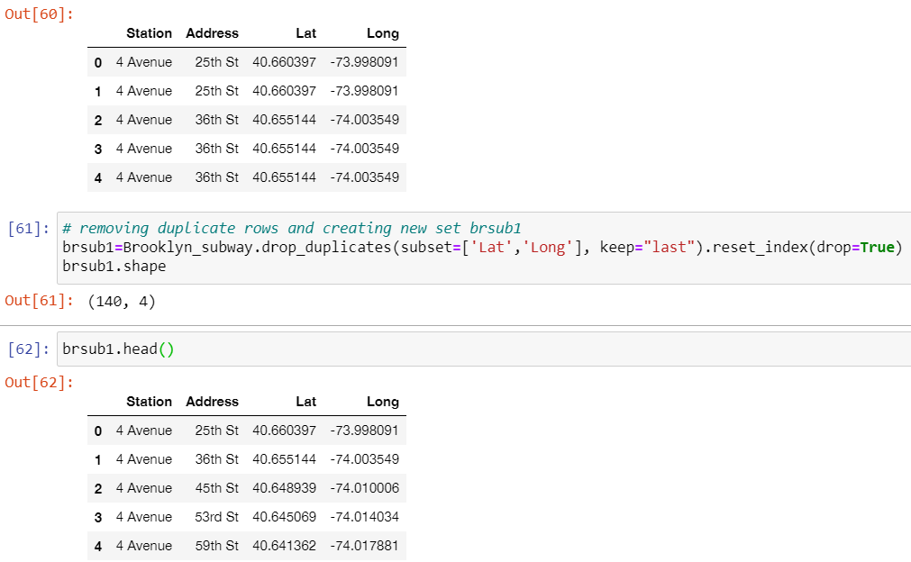
Brooklyn subway stations geodata

Slide 15
Apartment Selection
I was able to explore all possibilities since the popups provide the information needed for a good decision.
Apartment 1 and 2 rent cost is 3445$ and 3440$. Venues for this apartments are as of Cluster 0 and it is located in a fine district in the West side of Brooklyn.
Based on current Istanbul venues, I feel that Cluster 0 type of venues is a closer resemblance to my current place.

Slide 16
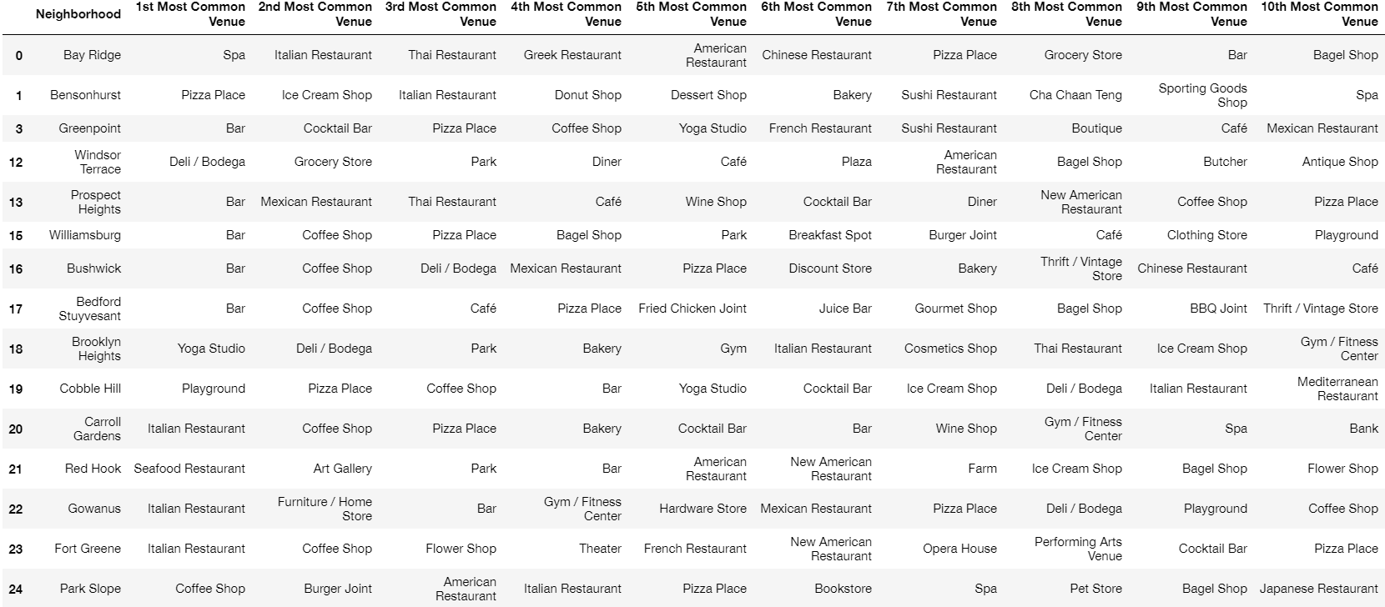
544 Union in Cluster 0 near future home

Slide 17
Discussion
In general, I am positively impressed with the overall organization, content and lab works presented during the Coursera IBM Certification Course
I feel this Capstone project presented me a great opportunity to practice and apply the Data Science tools and methodologies learned.
I have created a good project that I can present as an example to Show my potential.
I feel I have acquired a good starting point to become a Professional Data Scientist and I will continue exploring to creating examples of practical cases.

Slide 18
Conclusions
I feel rewarded with the efforts, time and money spent. I believe this course with all the topics covered is well worthy of appreciation.
This project has shown me a practical application to resolve a real situation that has impacting personal and financial impact using Data Science tools.
The mapping with Folium is a very powerful technique to consolidate information and make the analysis and decision thoroughly and with confidence. I would recommend for use in similar situations.
One must keep abreast of new tools for DS that continue to appear for application in several business fields.

